Slide 1

Iteration 1 presentation
Presenters Ryan Burns & Christol (Chenfei Yu)

Slide 2
Outline:
Project Overview
High Level: How does Rxcellent work?
Demo
Project Architecture
Design Pattern
Next Steps

Slide 3
Project Overview
Description:
Rxcellent is an e-pharmacy website where customers can order prescriptions and other drug store products without going to a brick and mortar store.
Goal:
Provide a platform for customers to get their prescriptions without needing to register or log in.
Implementation:
React.js for frontend
Express.js for the backend
MongoDB for our database
Vitest for testing
Vercel for deployment

Slide 4



How does Rxcellent Work?
Customer goes to doctor
Doctor writes an e-prescription on our site.
Customer gets a notification via e-mail letting them know the status of their prescription.
Customer gets prescription number by email.
The Rx number is uniquely generated with a hash function.
Customer goes to our site and enters their Rx number.
Customer will need to verify their birthday to move to next step.
Customer’s prescription will be displayed on the screen and given the option to purchase it.
Customers also have an option to buy OTC medication and other products commonly found at the pharmacy.
Notes:
In this Iteration we have runnable code and some features implemented. We plan to apply our figma design to our codebase. Move on to Figma demonstration.

Slide 5
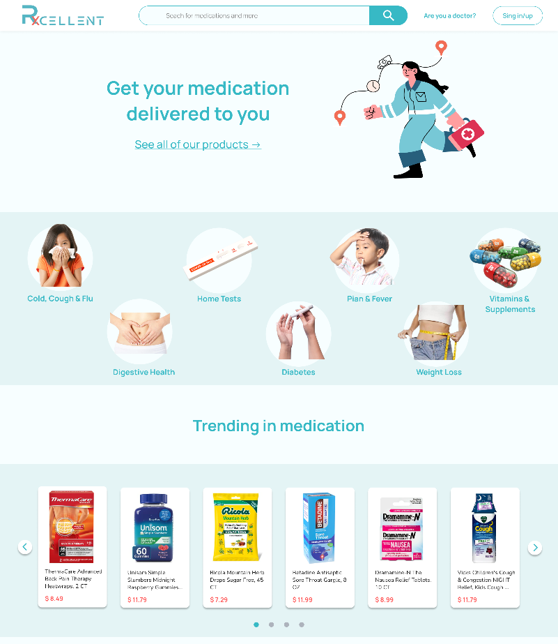
Design Prototype
Notes:
Should have demo open ready to demonstrate

Slide 6
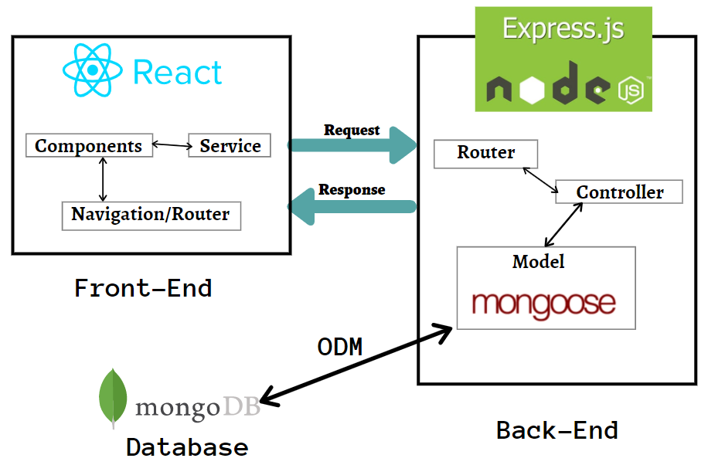
Project Architecture

Slide 7
Project Architecture
Frontend
Component — related to appearance or rendering of the content.
Services — CRUD (Create Read Update Delete) operations are done based on the user’s request and responses are rendered based on the result.
Navigation/router — navigation among various components. Eg: clicking on Get Prescription button will render the prescription details window. We need this notable concept because single-page automation will render the component within the component.
We use services to manipulate state and view, we use components to render pages on the browser, we use navigation to navigate between different pages and windows

Slide 8
Project Architecture
Backend
Express.js is a server application framework that runs on node.js. We will use its provided libraries to create our routers and controllers
Router will take the request that came from react.js and it will tell which controller will take the request and evaluate it.
Controller will evaluate and execute the request given by Router. (Eg: DB queries)
MongoDB
MongoDB uses a concept called ODM (Object Document Mapping). MongoDB is a schema-less document-based database.
From the model created, it will generate the schema and then it communicates with the database.
For converting a model to a schema, mongoose library is used.

Slide 9
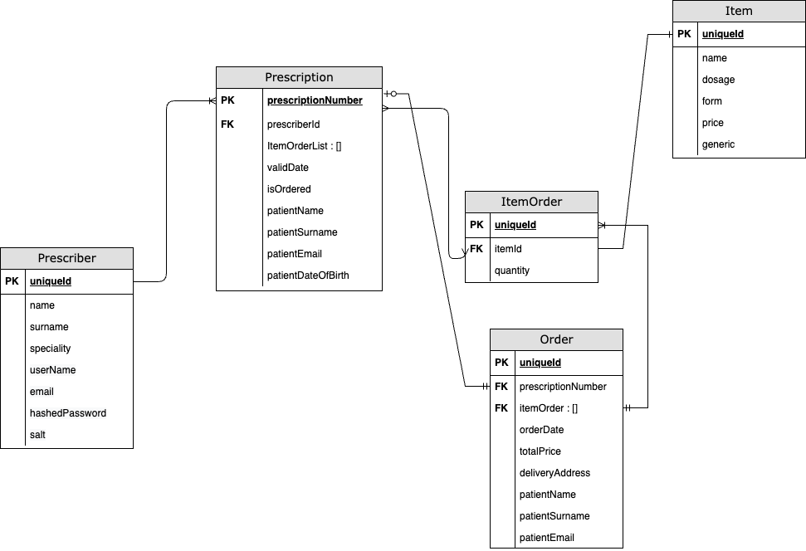
Database Design
Notes:
Prescriber table: stores the doctors/nurses info, their username and passwords in a secure way.
Prescription table: stores the prescriptions that is created by prescribers
Item table: Stores our items that we sell
ItemOrder table: Stores the items with quantities when they are prescribed or added to shopping cart
Order table : stores the customer orders that user created via his prescription or checking out OTC drugs

Slide 10
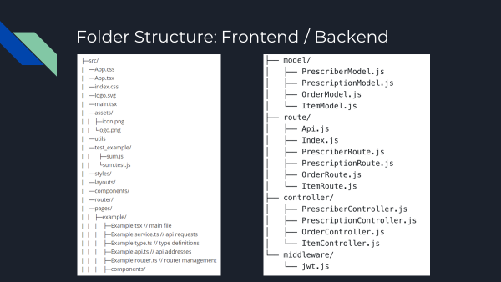

Slide 11
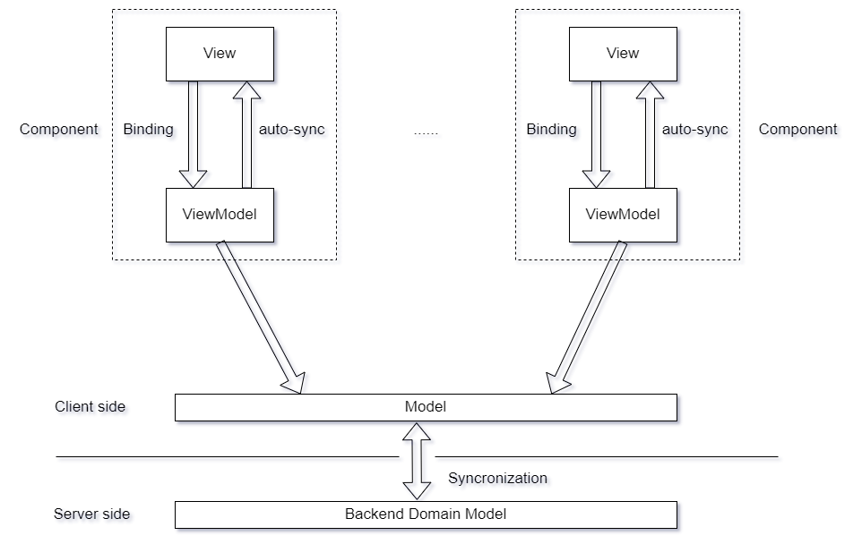
Design Pattern

Slide 12
Next Steps for Iteration 2
Implement the design into our codebase
Doctor/Prescriber Page
Follow the Security Guidelines we created
Implement the Backend

